Slide 1
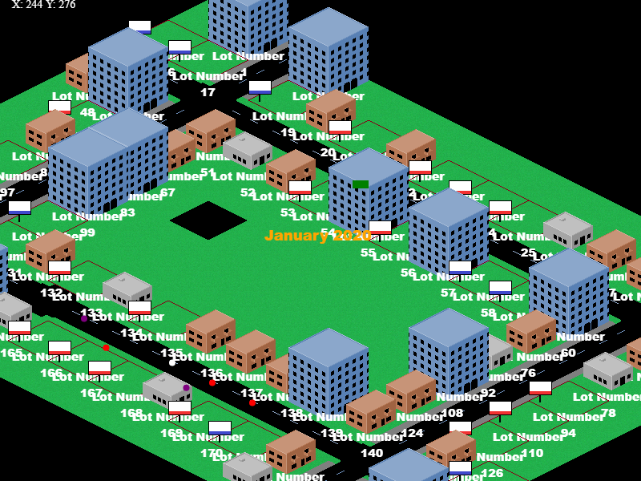
Springfield Property Manager
Pitch Date: July 5, 2020
Release Date: September 27, 2020
Team Lead: Vince McKeown

Slide 2
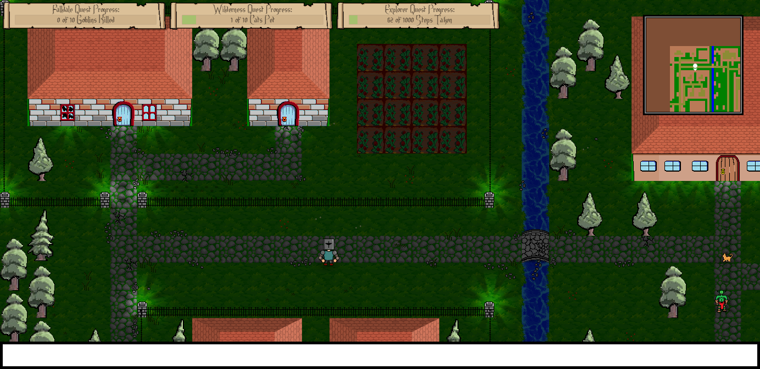
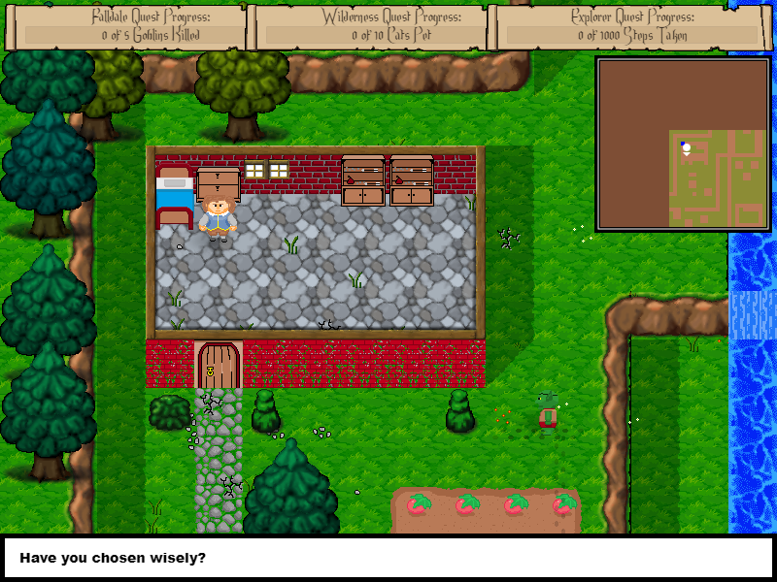
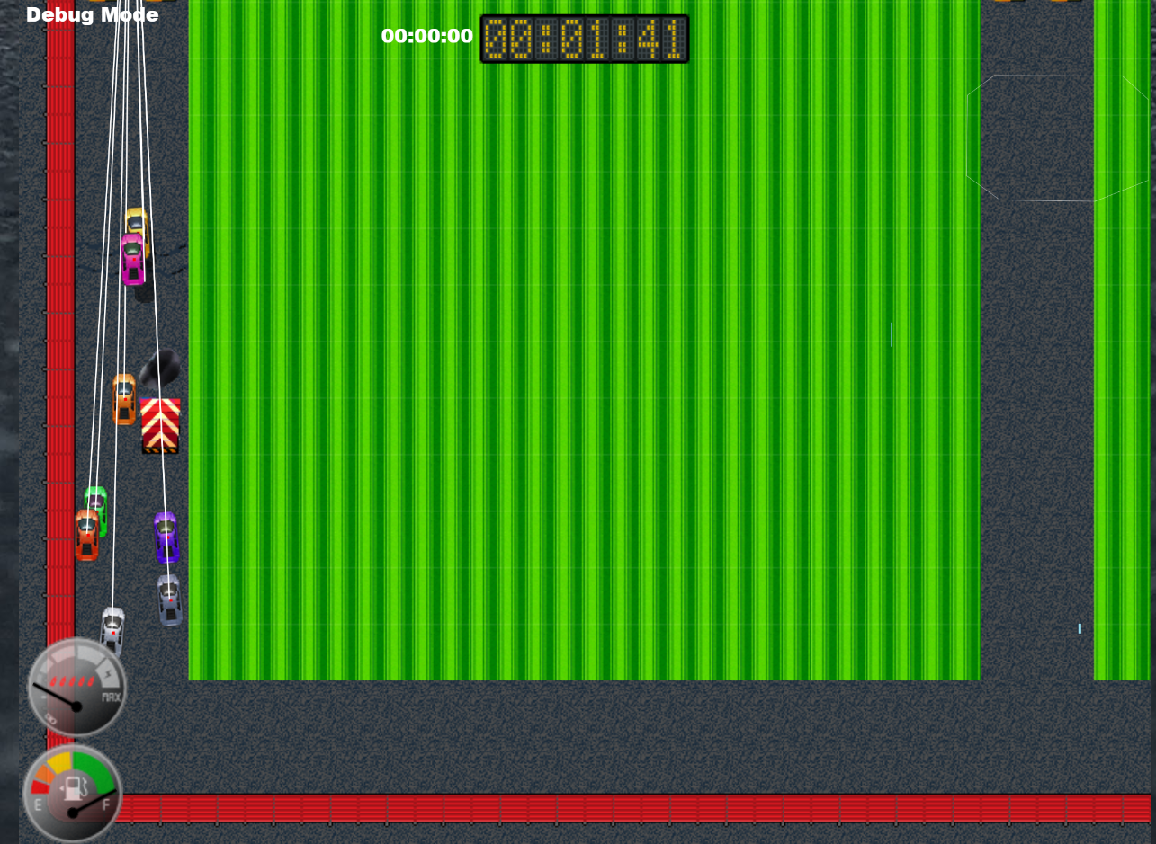
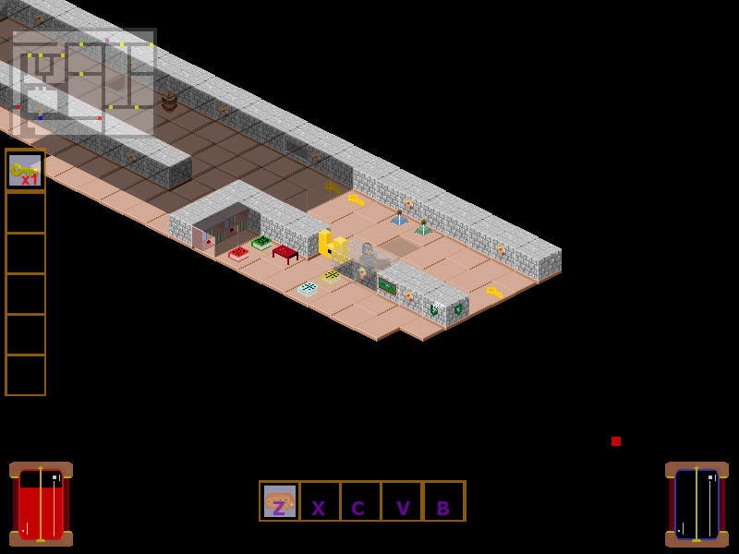
Prior Club Experience
Falldale
Little Racers
Game Changer
Descend Below the Crypts

Slide 3

Related Games
Simcity …..
Most of this game is origi

Slide 4
Demo
Cutover to Game

Slide 5
Vision
You have been given investment money from a wealthy relative. You’ve always been in competition with your siblings. Time will tell, who invested their funds the best within Springfield. You’ll have the options in investing or building from scratch residential and commercial properties.
You’ll have obstacles throughout time… unhappy tenants, new regulations, bad employees. You’ll also have windfalls of new opportunities.
You’re the Property Manager!

Slide 6
Schedule
Cutover to Trello

Slide 7
Roles
Art:
Buildings, People, Cutover Scenes
Sounds:
Noises of the City
Background Music

Slide 8
Roles
Code:
Artificial Intelligence for “Siblings”
AI “People” walking around town

Slide 9
Questions?
Who would like to take on this adventure with me?

